Slide 1
Weeding is FUN-damental!
The Essential Why and How of Weeding
Notes:
—my experience w/weeding—first 8 yrs ago and then merging two libraries

Slide 2

“Non revert quad multos, sed quad bonos habeas…”
Trans: “It does not matter how many (books), but how good they are…”
–Seneca, De Tranquillitate Animi
Notes:
—what is weeding: As defined by Crew, A Weeding Manual for Modern Libraries, weeding is the systematic removal of resources from a library based on selected criteria. It is the opposite of selecting material, though the selection and de-selection of material often involve the same thought process. Weeding is a vital process for an active collection because it ensures the collection stays current, relevant, and in good condition. Weeding should be done on a continuous, on-going basis.[1]
—origins of weeding debate: Quincy Plan—Crane Memorial Public Library built by Richardson in Quincy, MA, in 1882. By 1892, almost to capacity. Adams, lib trustee, proposed transferring research materials to more convenient locations for patrons and removing all but the most popular materials—huge/heated debate at the 1893 ALA convention, never ended.

Slide 3

S.M.A. (So Many Acronyms)

Slide 4
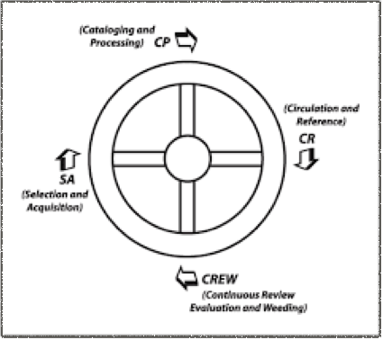
CREW
Continuous Review
Evaluation
Weeding

Slide 5
MUSTIE(Y)
Misleading
Ugly
Superseded
Trivial
Irrelevant
Elsewhere
(Your Collection)
Notes:
M—inaccurate
U—damaged, worn, old fashioned covers
S—new editions? Additional info?
T—fleeting interest? Movie tie in/popular culture
I—irrelevant to your collection
E—can we source this somewhere else?
(Y—Is it needed for your collection? You know your community.)

Slide 6
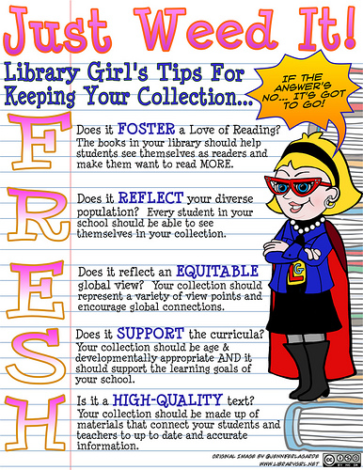
Notes:
Foster love of reading
Reflect your population
Equitable global view—diverse viewpoints
Support the curriculum
High quality texts, current and accurate

Slide 7

The 3 Cs
Curation =
Condition + Content + Circulation
Notes:
Sums up as the 3 Cs

Slide 8
How to Weed…

Slide 9
Before Getting Started
Create a Weeding Policy, which should be part of your collection development policy.
Be open and transparent with stake holders, use examples, but don’t apologize or ask permission.
Make a plan of attack!

Slide 10
Weeding Plan
What are your criteria for weeding?
What are your plans for disposal? Check your district’s policies and with fellow librarians for guidance.
How much are you tackling at one time? It can be easier and less traumatic on all sides to do one section at a time—15 min plan.
Notes:
—some books may need to be recataloged or put on a special display

Slide 11
To Meet SC State Standards
Weed 3% per year
Elementary: 60% fiction, 40% nonfiction
Fiction copyright—no more than 17 years
Nonfiction copyright—no more than 7 years
Overall date—no more than 13 years

Slide 12
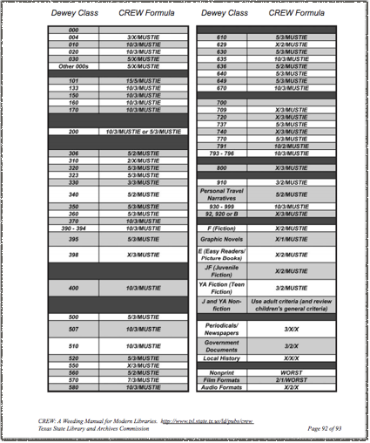
The CREW Weeding Formula
In the CREW formula for weeding, the first number equals the number of years since the book was published, the second number indicates how many years since the book has circulated, and the third is a reminder to use the factors in MUSTIE.
If there is an X in place of a number, the number is less of a priority than usual; for instance, in fiction, copyright date is less important than content and condition.

Slide 13
CREW Example:
610 Medicine and Health: 5/3/MUSTIE
745.1 Graphic Novels: X/1/MUSTIE

Slide 14
Why Weed?

Slide 15
To Save Space (Shelves 80% full)
To Save Time for Everyone
To Make the Collection More Appealing
To Make The Collection More Reliable
To Increase Your Knowledge of the Collection
Curation increases Circulation!
Notes:
—easier to browse, not overwhelming

Slide 16
Why Do We Resist Weeding?

Slide 17
Common Concerns
We need a certain number of books per student.
A teacher/student might need this book.
I loved this book or series when I was a kid/It’s a classic!/It’s an award winner!
If I weed this, we won’t have enough on this topic.
It makes my teachers mad when I weed.
Notes:
Milk analogy—if the milk is expired, do you put it back in the fridge so you’ll still have milk? Is bad milk better than no milk?
Recatalog titles
Make special display
Try book talks or having teachers talk them up

Slide 18
What to do with weeded materials?
Sell
Donate
Trade
Recycle
Destroy
Check with your district’s disposal policies!

Slide 19
Go to kahoot.it or open the Kahoot App…

Slide 20
Resources
Admin. “Weeding Library Collections: A Selected Annotated Bibliography for Library Collection Evaluation.” Tools, Publications & Resources, 8 June 2018, www.ala.org/tools/libfactsheets/alalibraryfactsheet15.
Cslasouthernsection, director. Weed It! CSLA 2010 Book Cart Drill Team. YouTube, YouTube, 13 Nov. 2010, www.youtube.com/watch?v=50aUM6vWFxY.
Dickinson, Gail. “Crying Over Spilled Milk.” Library Media Connection, vol. 23, no. 7, 2005, pp. 24–26.
Dilevko, Juris, and Lisa Gottlieb. “Weed to Achieve: a Fundamental Part of the Public Library Mission?” Library Collections, Acquisitions, and Technical Services, vol. 27, no. 1, 2003, pp. 73–96., doi:10.1016/s1464-9055(02)00308-1.
James, Christine. “Weeding to Let My Collection Grow.” Knowledge Quest, 8 May 2017, knowledgequest.aasl.org/weeding-let-collection-grow/. Short anecdotal article on the author's personal experiences with weeding her her library.
Kelly, Mary. “Dealing With the Staff Hoarder.” Awful Library Books, 23 Apr. 2016, awfullibrarybooks.net/dealing-with-the-staff-hoarder/.
Larson, Jeanette, and Belinda Boon. CREW: a Weeding Manual for Modern Libraries. Texas State Library and Archives Commission, 2012. The 2008 pdf of this book can be found online here: https://www.tsl.texas.gov/sites/default/files/public/tslac/ld/pubs/crew/crewmethod08.pdf
“South Carolina Department of Education.” Standards for School Library Resource Collections - South Carolina Department of Education, 2016, ed.sc.gov/educators/school-and-district-administrators/certified-support-specialists/library-media-specialists/standards-for-school-library-resource-collections/.

